Slide 1
Database Management Systems
許 中 川
Office: MB406, Tel: 5326
Email: hsucc@yuntech.edu.tw
Office hours: 16:00~17:30 (Tue., Fri.)
or by appointment

Slide 2
課程所要培養的學習目標
講授資料庫系統相關知識
了解資料庫管理系統之架構
有能力設計資訊系統所需的資料庫之架構
有能力建置資料庫
有能力查詢與修改資料庫內容
有能力評量資料庫架構設計之優劣
了解資料庫安全相關議題

Slide 3
此課程評量方式及其比例分配
三次考試 (65%)
兩節課考試，第三節上課(期末考週除外)
網路學園自我測驗 (15%)
每週課後網路學園自我測驗
小組專案作業（15%）
每組四人為原則
課程參與 (5%)
課堂互動及出席率

Slide 4
Some Notes
Course materials: 課程投影片置於雲科大網路學園
Textbook:
Elmasri, R. et al., Database Systems-Models, Languages, Design, and Application Programming, 6th ed., 2010, Pearson, 歐亞書局
助教: 吳俊逸，分機：5397，m10623017@yuntech.edu.tw
Others:
每周課後請至網路學園進行自我測驗。(未寫完提交前，請勿關掉測驗網頁，否則測驗結束，沒有分數，也無法重測)
網路自我測驗有問題，請在測驗時間截止前向助教反應，否則無法補救
考試會有英文出題，平時請務必閱讀原文課本，以免屆時看不懂題目
考古題公布於網路學園，考試時考古題與網路學園題目各占約10%

Slide 5
Some Notes-2
請把握三次測驗、線上自我測驗及作業成績
無法針對私人因素，個別調整學期期末成績
無法參加考試，請依學校程序請假，並事先知會老師
上課前請開妥投影機及電腦，下載並開啟最新課程投影片
學好本課程的要領：課前預習投影片，課後當天馬上複習上課內容
上課不可睡覺、聊天、使用手機。違者每次扣兩分

Slide 6
What is this course all about?
Mini-world
(YunTech)
DB
DBMS
How to place mini-world data into database?
Design the DB’s structure (how and quality)
Construct the DB (define schema and load data)
How to retrieve data from database?
Interfaces that DBMS offers (interactive and API)

Slide 7
Course Content
How to place mini-world data into database?
Design the DB’s structure (how and quality)
Construct the DB (define schema and load data)
How to retrieve data from database?
Interfaces that DBMS offers (interactive and API)
Mini-world
DB
DBMS
Ch03: The Basic (Flat) Relational Model
Ch10: Object and Object-Relational Databases
Ch11: XML: Concepts, Languages, and Standards
Ch04: SQL: Data Definition, Constraints, and Basic Queries and Updates
Ch05: SQL: Advanced Queries, Assertions, Triggers, and Views
Ch07: Conceptual Data Modeling Using Entities
Ch08: Mapping a Conceptual Design into a Logical Design
Ch09: UML for Database Application Design
Ch12: SQL Application Programming Using C and Java
Ch13: SQL Web Programming Using C PHP
Ch 14: Database Design Theory: Normalization and Dependencies
Data Model
Construct
Retrieve
Design
API
Quality

Slide 8
Chapter 1
Introduction to Databases

Slide 9
Ch1: Introduction to Databases
Mini-world
Introduction
An Example
Characteristics of the DB Approach
Actors on the Scene
Workers behind the Scene
Advantages of Using the DBMS Approach
A Brief History of DB Applications
When Not to Use a DBMS
DB
DBMS

Slide 10
Basic Definitions
Mini-world
DB
Database
A collection of related data.
Data
Known facts that can be recorded and have an implicit meaning.
Mini-world
Some part of the real world about which data is stored in a database. For example, student grades and transcripts at a university.
Database Management System (DBMS)
A software package/ system to facilitate the creation and maintenance of a computerized database.
Database System
The DBMS software together with the data itself. Sometimes, the applications are also included.
DBMS

Slide 11
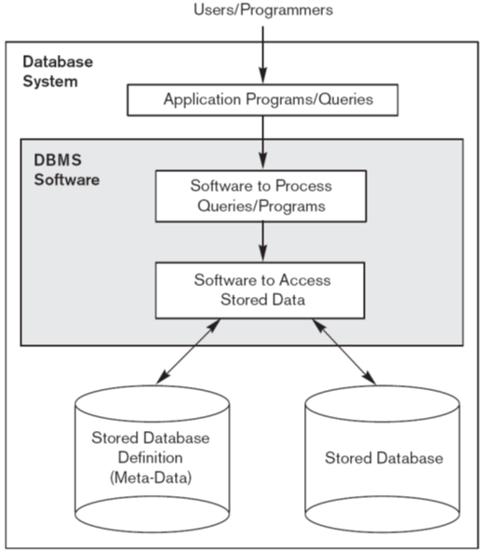
FIGURE 1.1 A simplified database system environment.
Mini-world
DB
DBMS

Slide 12
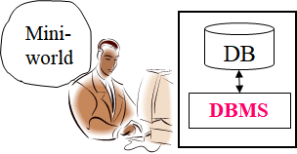
Typical DBMS Functionality-1
Define a database
in terms of data types, structures and constraints約束
Construct or Load the Database
on a secondary storage medium
Manipulate(操作) the database
Querying查詢, generating生成, insertions插入, deletions刪除 and modifications修改 to its content內容

Slide 13

Typical DBMS Functionality-2
Concurrent Processing and Sharing by a set of users and programs – yet, keeping all data valid and consistent
Protection or Security measures to prevent unauthorized access
“Active” processing to take internal actions on data
Presentation and Visualization of data
x
DB
DBMS

Slide 14
Example of a Database
Mini-world for the example
Part of a UNIVERSITY environment
真實世界的資料儲存在資料庫中.
Some mini-world entities:
STUDENTs
COURSEs
SECTIONs (of COURSEs)
(academic) DEPARTMENTs
INSTRUCTORs
Some mini-world relationships:
SECTIONs are of specific COURSEs
STUDENTs take SECTIONs
COURSEs have prerequisite COURSEs
INSTRUCTORs teach SECTIONs
COURSEs are offered by DEPARTMENTs
STUDENTs major in DEPARTMENTs
Mini-world
YunTech
DB
DBMS

Slide 15
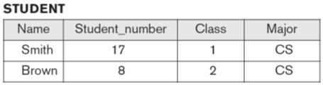
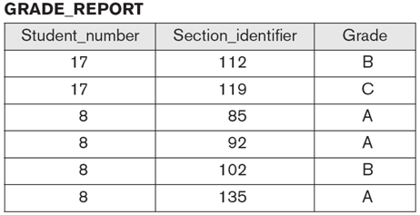
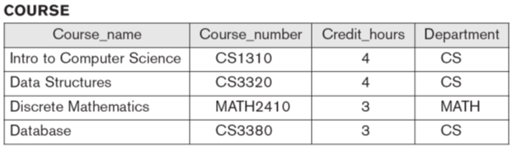
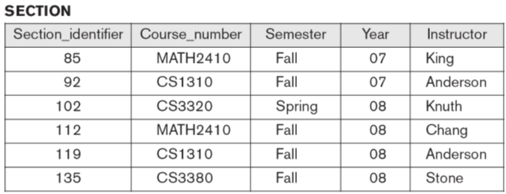
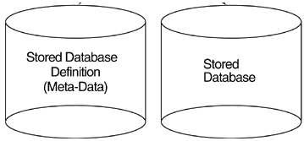
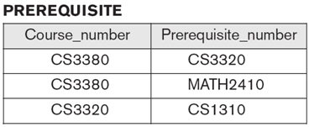
FIGURE 1.2 A database for student and course information
University
DB
DBMS

Slide 16
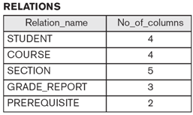
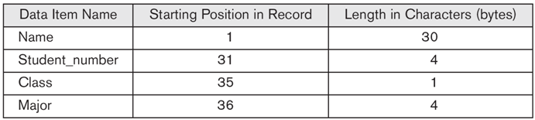
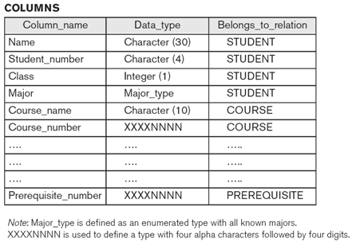
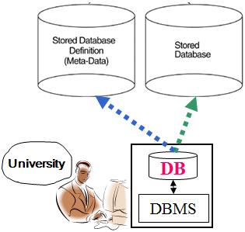
Main Characteristics of the Database Approach
meta-data Self-describing
meta-data = A DBMS catalog stores the description of the database.
This allows the DBMS software to work with different databases.
Internal storage format for a STUDENT record

Slide 17
Main Characteristics of the Database Approach
Insulation between programs and data
Called program-data independence.
Allows changing “data storage structures” and “operations” without having to change the DBMS access programs訪問程序.
University
DB
Application Programs
DBMS

Slide 18
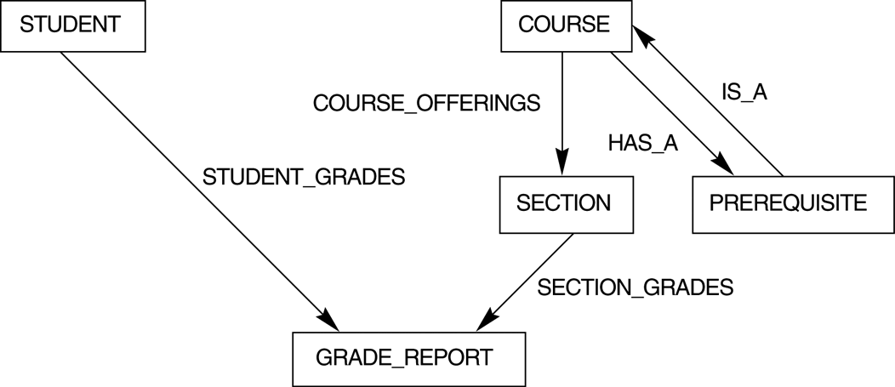
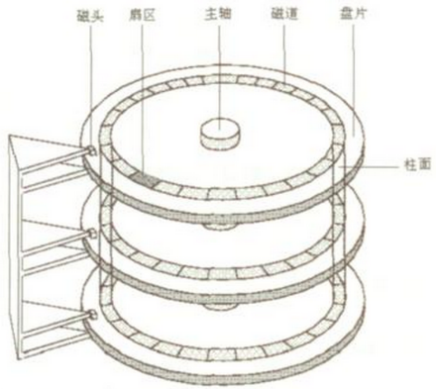
Main Characteristics of the Database Approach
Data Abstraction
A data model is used to用於 hide storage details and present the users with a conceptual view of the database.
A
B
C
Computer Storage

Slide 19
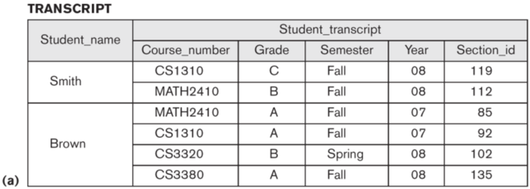
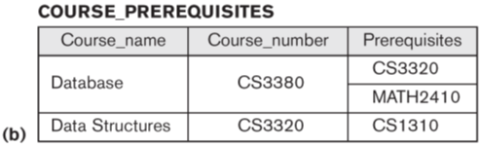
FIGURE 1.4 Two views derived from the database in Figure 1.2 (a) The STUDENT TRANSCRIPT view. (b) The COURSE PREREQUISITES view.
Support of multiple views of the data
Each user may see a different view of the database, which describes only the data of interest to that user.
DB
DBMS

Slide 20
Main Characteristics of the Database Approach
Sharing of data and multiuser transaction processing
allowing a set of concurrent users to retrieve and to update the database.
Concurrency control within the DBMS guarantees that each transaction is correctly executed or completely aborted.
OLTP (Online Transaction Processing) is a major part of database applications.
DB
DBMS

Slide 21
Database Users
Users may be divided into
Actors on the Scene
those who actually use and control the content
Workers Behind the Scene
those who enable the database to be developed and the DBMS software to be designed and implemented.
Mini-world
DB
DBMS
Actors on the scene
Workers behind the scene:
DBMS system designers and implementers
Tool developers
Operators and maintenance personnel

Slide 22
Actors on the Scene
Mini-world
DB
Database administrators:
authorizing access to the database,
coordinating and monitoring its use,
acquiring software, and hardware resources, controlling its use
monitoring efficiency of operations.
Database Designers:
define the content, the structure, the constraints, and functions or transactions against the database.
communicate with the end-users and understand their needs.
System Analysts and Application Programmers
End-users:
they use the data for queries, reports and some of them actually update the database content.
DBMS
Actors on the scene

Slide 23

Categories of End-users-1
Casual
Access database occasionally when needed; use a sophisticated DB query language;
Typically middle- or high-level managers
Naïve or Parametric
They make up a large section of the end-user population. They use previously well-defined functions in the form of “canned transactions” against the database.
Examples are bank-tellers or reservation clerks who do this activity for an entire shift of operations.

Slide 24
Categories of End-users-2
Sophisticated
business analysts, scientists, engineers, others thoroughly familiar with the system capabilities.
Many use tools in the form of software packages that work closely with the stored database.
Stand-alone
mostly maintain personal databases using ready-to-use packaged applications.
An example is a tax program user that creates his or her own internal database.

Slide 25
Advantages of Using the Database Approach
Controlling redundancy in data storage and in development and maintenance efforts.
Restricting unauthorized access to data.
Providing persistent storage for program objects
Providing storage structures for efficient query processing
Providing backup and recovery services.
Providing multiple interfaces to different classes of users.
Representing complex relationships among data.
Enforcing integrity constraints on the database.
Permitting inference and actions using rules
DB
DBMS

Slide 26
Advantages of Using the Database Approach
Permitting inference from data
ID | Name | Parent
A | Tom | John
B | John | York
C | York | Gary
Tom’s ancestors?
Representing complex relationships among data
Permitting action using rules
ID | Name | MinQnt | Quantity
1 | Coke | 10 | 12
2 | Pepsi | 10 | 40
3 | Latte | 10 | 70
… | … | … | …
Trigger:
If ID.Quantity < ID.MinQnt, then Order_Product(ID.Name)

Slide 27
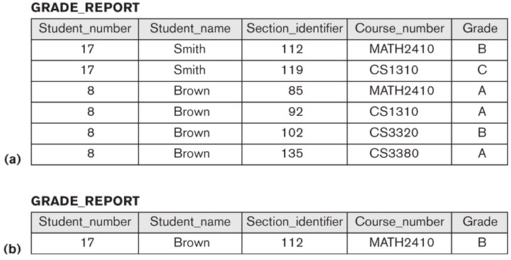
FIGURE 1.5 Redundant storage of StudentName and CourseNumber in GRADE_REPORT. (a) Consistent data. (b) Inconsistent record.
DBMS can help automatically check consistency of the controlled redundancy, which is for improving query performance.

Slide 28
Additional Implications of Using the Database Approach
Potential for enforcing standards
crucial for the success of database applications in large organizations.
Standards refer to data item names, display formats, screens, report structures, meta-data (description of data) etc.
Reduced application development time
incremental time to add each new application is reduced.
Flexibility to change data structures
database structure may evolve as new requirements are defined.
Availability of up-to-date information
very important for on-line transaction systems such as airline, hotel, car reservations.
Economies of scale
by consolidating data and applications across departments, wasteful overlap of resources and personnel can be avoided.
DB
教務處
學務處
圖書館
…
DBMS

Slide 29
Historical Development of Database Technology
Early Database Applications
The Hierarchical and Network Models were introduced in mid 1960’s and dominated during the seventies.
A bulk of the worldwide database processing still occurs using these models.
Relational Model based Systems
The model that was originally introduced in 1970 was heavily researched and experimented with in IBM and the universities.
Relational DBMS Products emerged in the 1980’s.

Slide 30
Historical Development of Database Technology
Object-oriented applications
OODBMSs were introduced in late 1980’s and early 1990’s to cater to the need of complex data processing in CAD and other applications.
Their use has not taken off much.
Data on the Web and E-commerce Applications
Web contains data in HTML (Hypertext markup language) with links among pages.
This has given rise to a new set of applications and E-commerce is using new standards like XML (eXtended Markup Language).

Slide 31
Extending Database Capabilities
New functionality is being added to DBMSs in the following areas:
Scientific Applications
Image Storage and Management
Audio and Video data management
Data Mining
Spatial data management
Time Series and Historical Data Management
The above gives rise to new research and development in incorporating new data types, complex data structures, new operations and storage and indexing schemes in database systems.

Slide 32
When not to Use a DBMS
Main inhibitors (costs) of using a DBMS:
High initial investment and possible need for additional hardware.
Overhead for providing generality, security, concurrency control, recovery, and integrity functions.
When a DBMS may be unnecessary:
If the database and applications are simple, well defined, and not expected to change.
If there are stringent real-time requirements that may not be met because of DBMS overhead.
If access to data by multiple users is not required.
When no DBMS may suffice:
If the database system is not able to handle the complexity of data because of modeling limitations
If the database users need special operations not supported by the DBMS.

